Slide 1
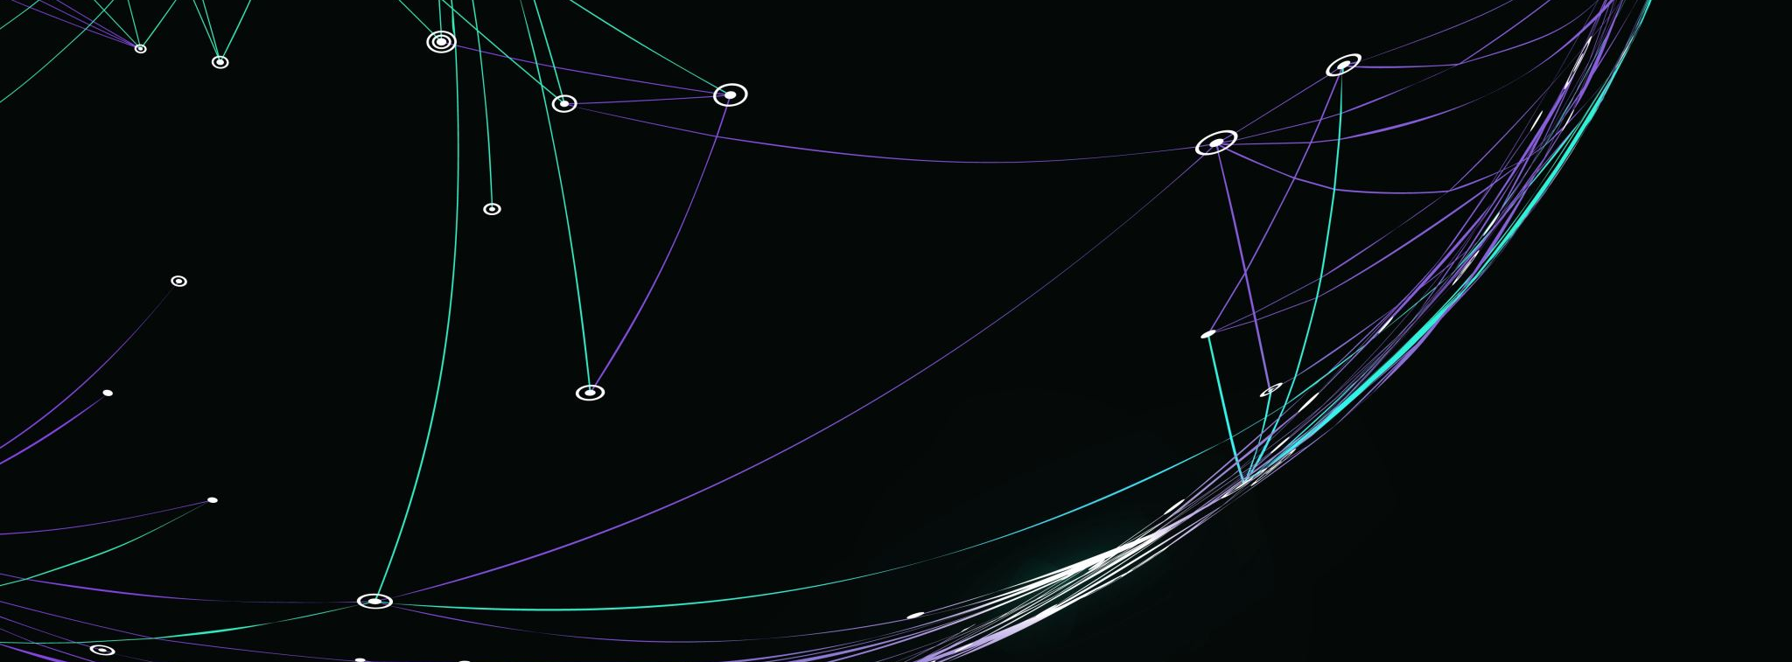
The Moses Experience
By: The Red Sea-Sharp

Slide 2
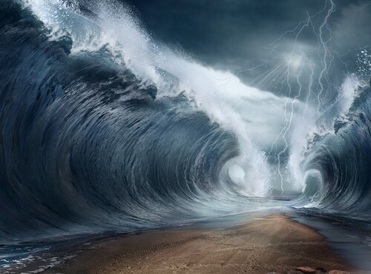
Purpose of the Project
“The purpose of this project is to create a visual experience that exemplifies the power of God’s miracle at the Red Sea”
People do not understand the magnitude of the event that occurred, so this project attempts to show a dramatic representation of this historical event.
Figure 1: https://www.ldsliving.com/what-parting-the-red-sea-teaches-us-about-the-new-and-everlasting-covenant/s/87304

Slide 3
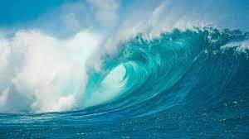
Group Member’s Participation
https://kids.nationalgeographic.com/nature/habitats/article/ocean

Slide 4
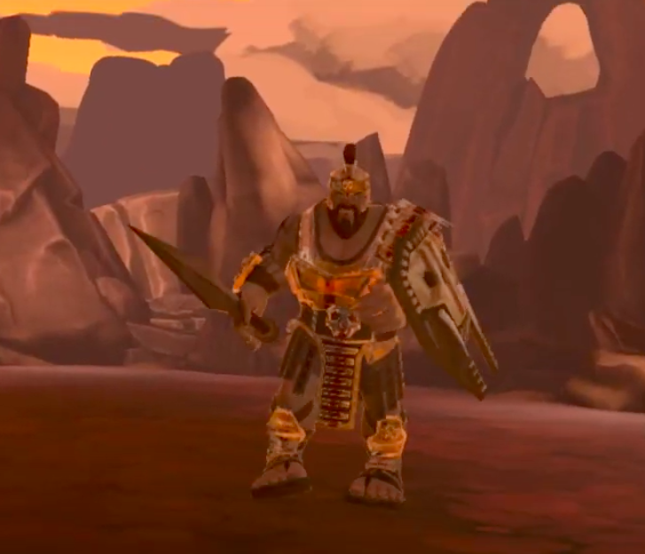
Background
DvG – a game that tells the story of David and Goliath but is not available to play yet.
VR Church: The Bible – an application that lets you read the Bible in a calm virtual environment.
Required Technology – Unity, Maya, C#, Adobe Photoshop, Adobe Illustrator, Adobe Premier, Adobe Premier, FL Studio 20, Audacity, Microphone, GitHub
https://www.youtube.com/watch?time_continue=48&v=pX5jMBuLVH4&feature=emb_title

Slide 5
Target Users
Christians who simply want an easy way to get familiar with the Biblical stories, specifically the story in Exodus
Non-Christians who may not be familiar with the biblical stories
People with access to virtual reality equipment that have a headset and hand-controllers.
Through this project, we can give them an accessible way to get familiar with important parts of the Bible.

Slide 6

Project Plan
https://www.freeiconspng.com/images/checkmark-png
March 2: Prop Models completed
- Have most of our general environment design and modeling done this will be done by our modeling team
March 23: Usability Test
- Have some general interactions done mostly focused on game navigation
- Have our environment fully finished with added items on the ground like
coral reefs and extra driftwood, treasure, etc.
- Have all our items textured and place them within the environment
April 13
- Have all of the interactions and navigations working smoothly
- Have the game debugged

Slide 7
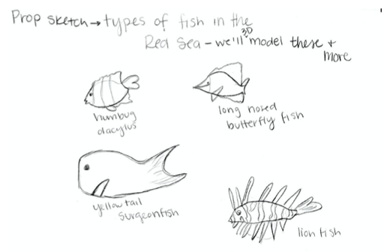
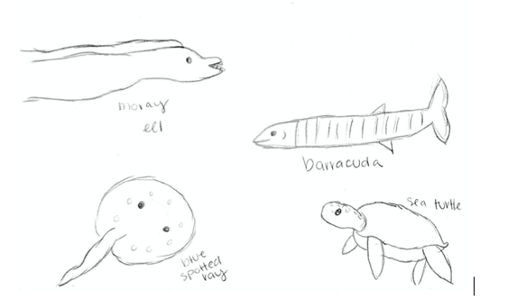
Prop Design and Sketches
Notes:
I just thought I’d preface this by saying I, Melissa, am a digital artist and do not sketch very often, so they are very abstract sketches that hopefully convey our ideas.
a prop sketch of some of the fish found in the red sea that we will 3D model in Maya and add to our game mode and also place them within the water. All of these fish species can be found within the red sea and therefore we want our application to be as geographically accurate as it can be.

Slide 8
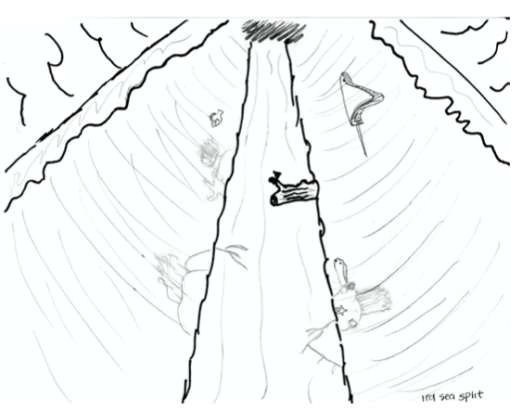
Prop Design and Sketches
Notes:
an environment sketch of what our general environment will look like once the red sea is split. I will have a pathway with the two walls of water on either side. There will be fish swimming in the water and some items found along the pathway.

Slide 9
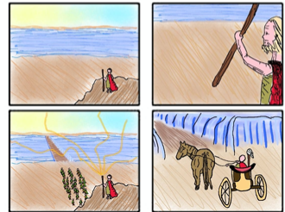
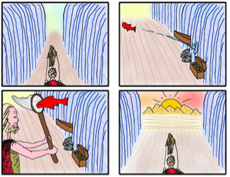
Prop Design and Sketches
Notes:
This is a storyboard of our project by Kieran Clark

Slide 10


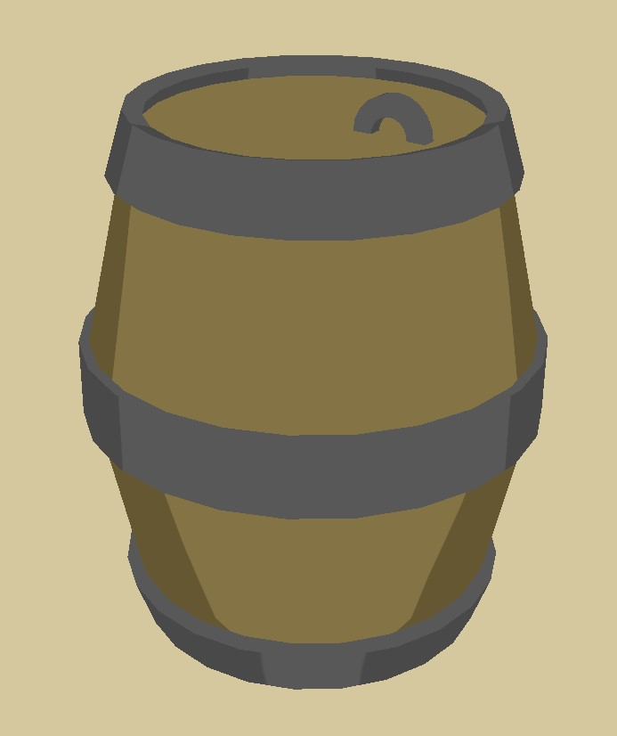
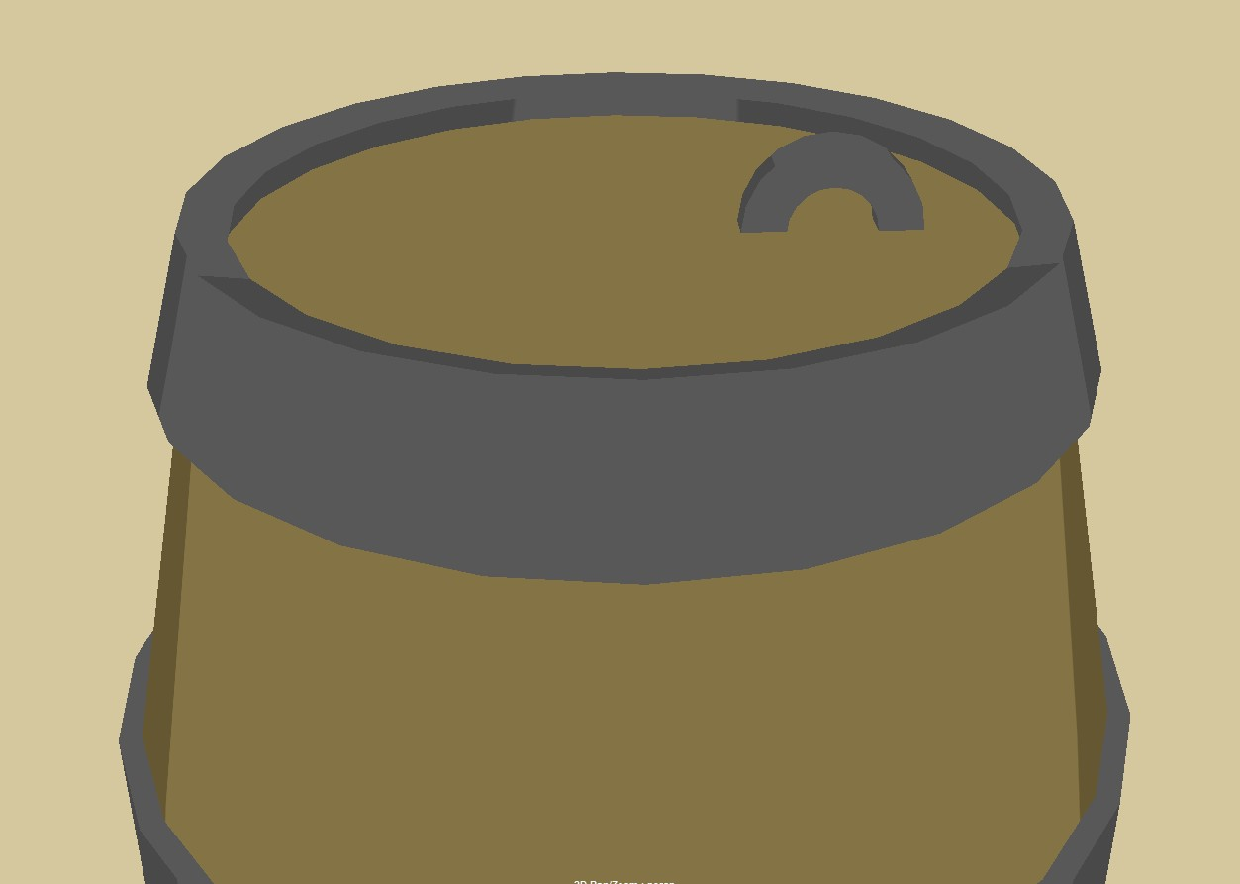


Barrel / Chest- Kieran

Slide 11




Starfish- Kieran

Slide 12

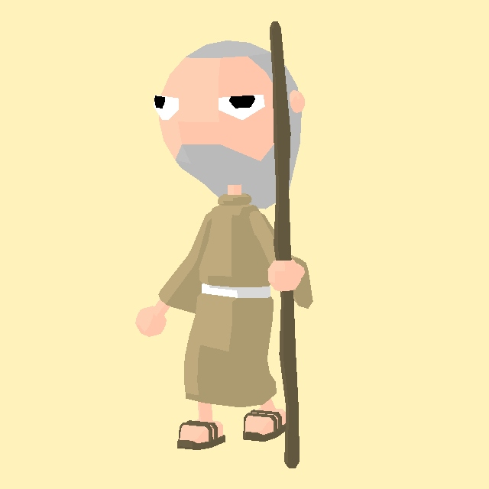
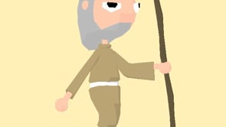
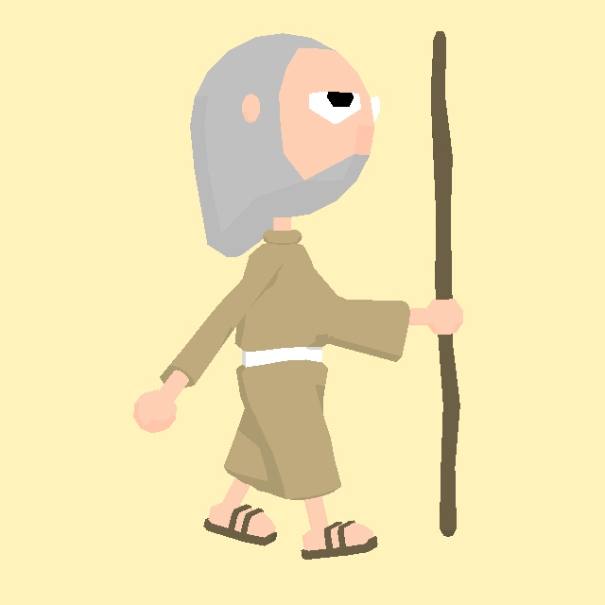
Moses- Kieran
Video of Animation

Slide 13
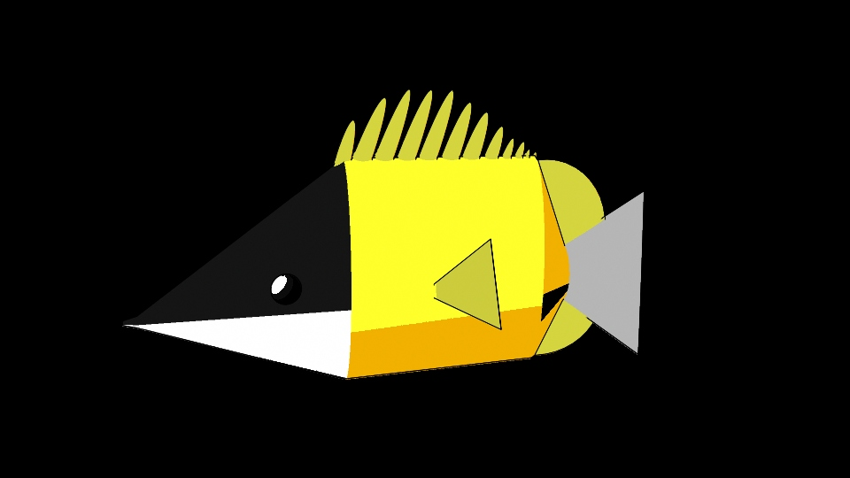
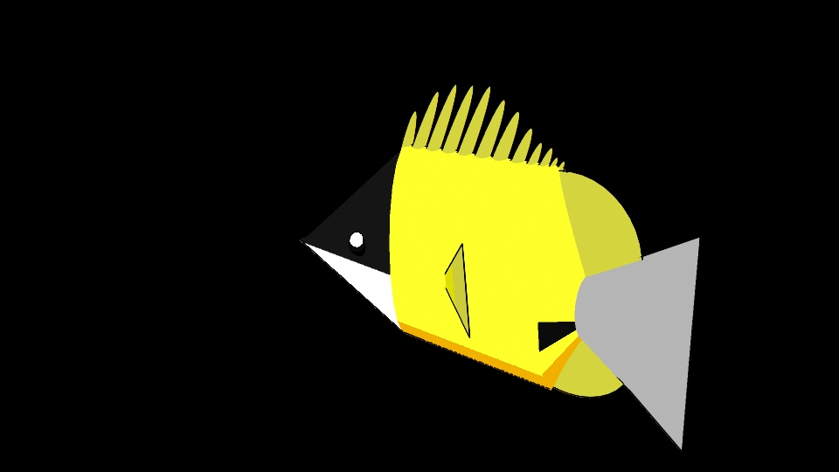
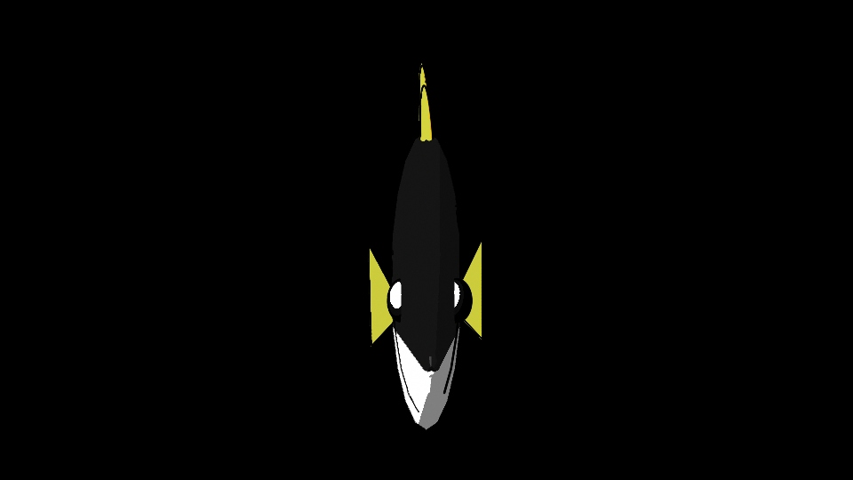
Butterfly Fish- Melissa

Slide 14

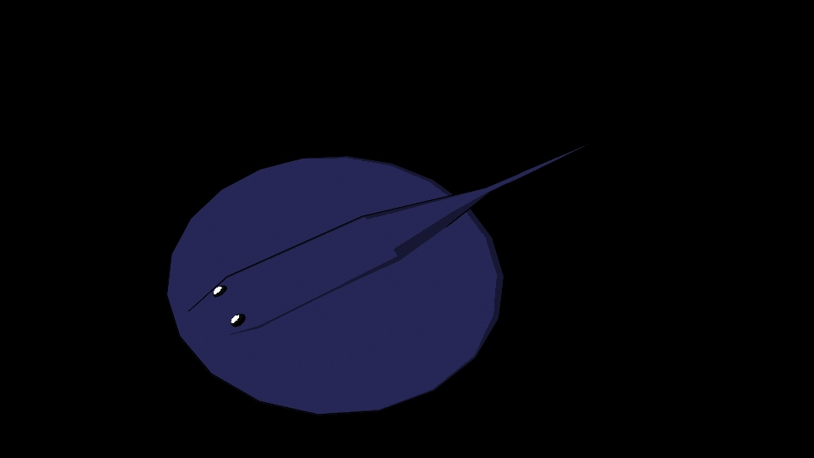
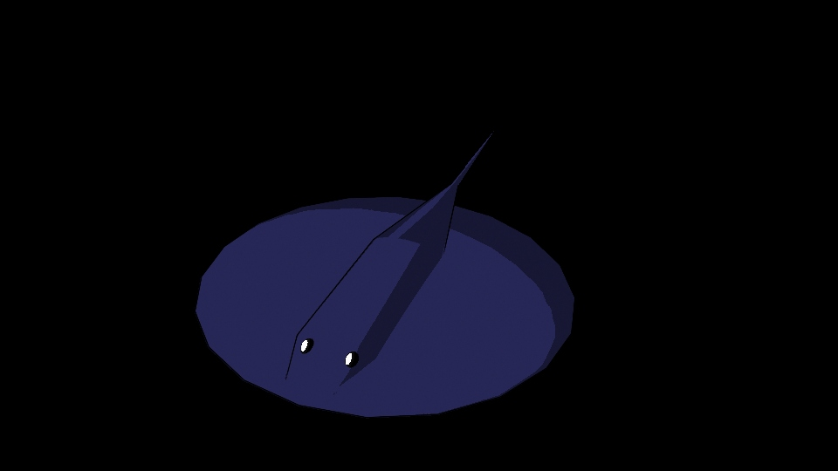
Manta Ray- Melissa

Slide 15
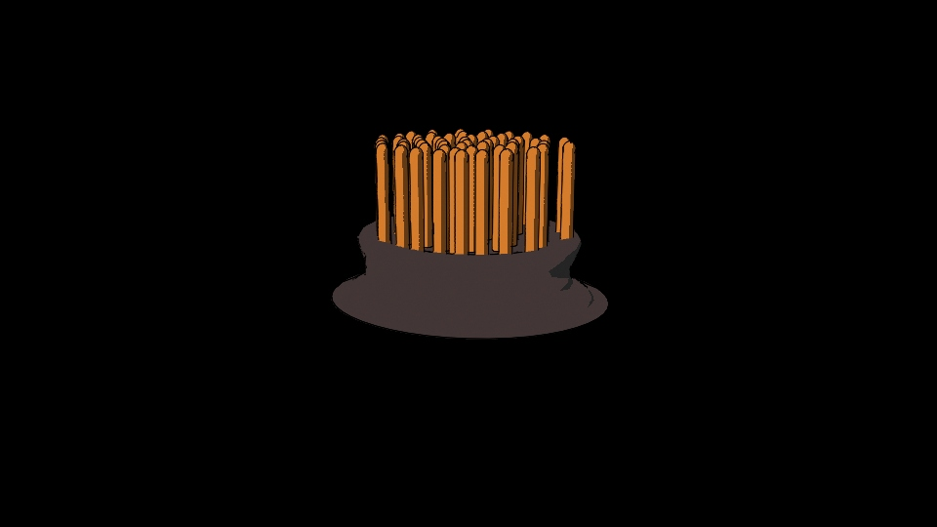
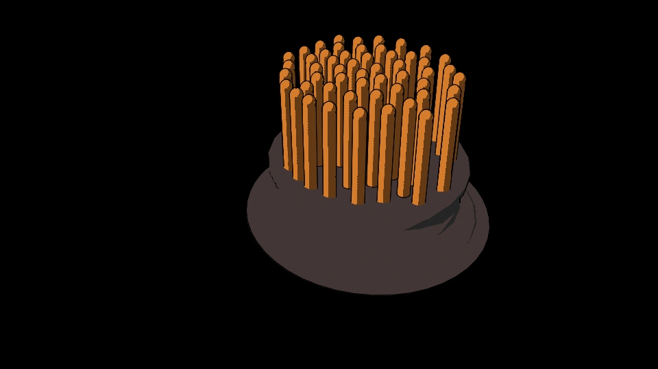
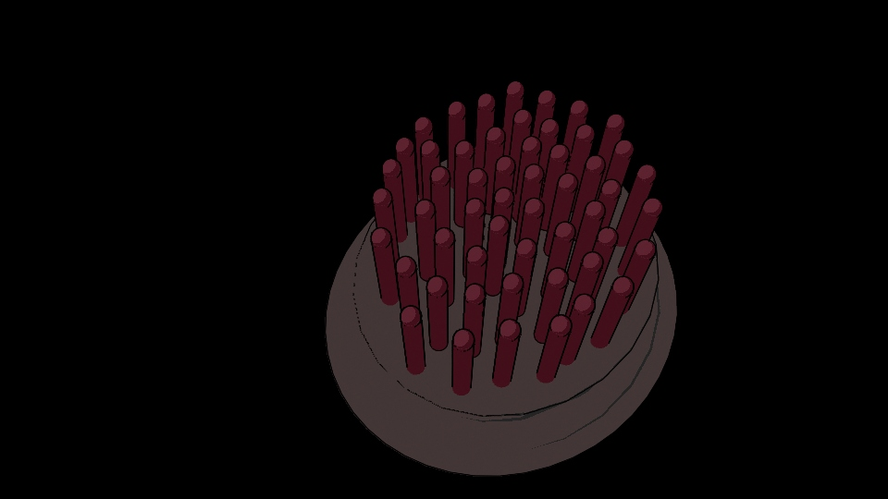
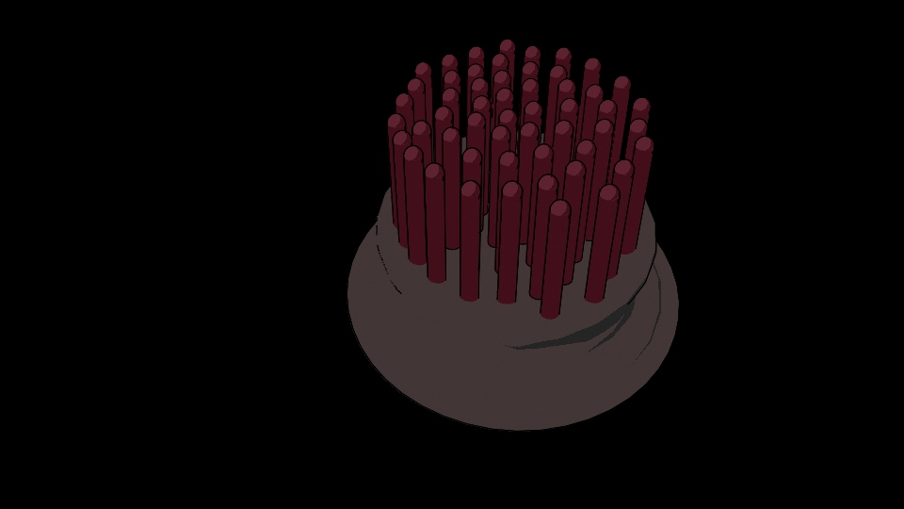
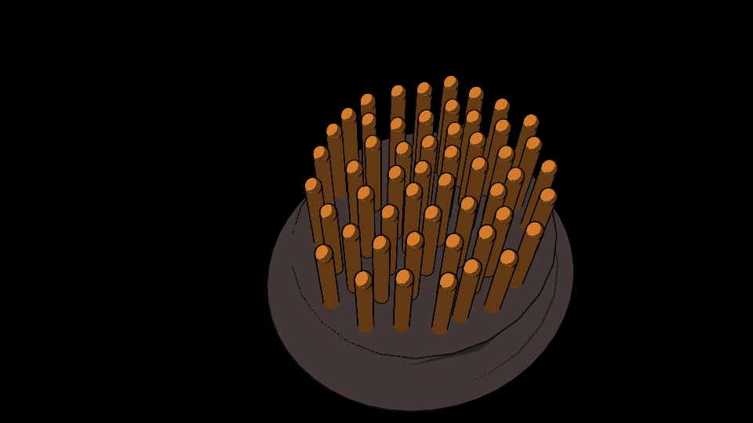
Sea Anemone- Melissa

Slide 16
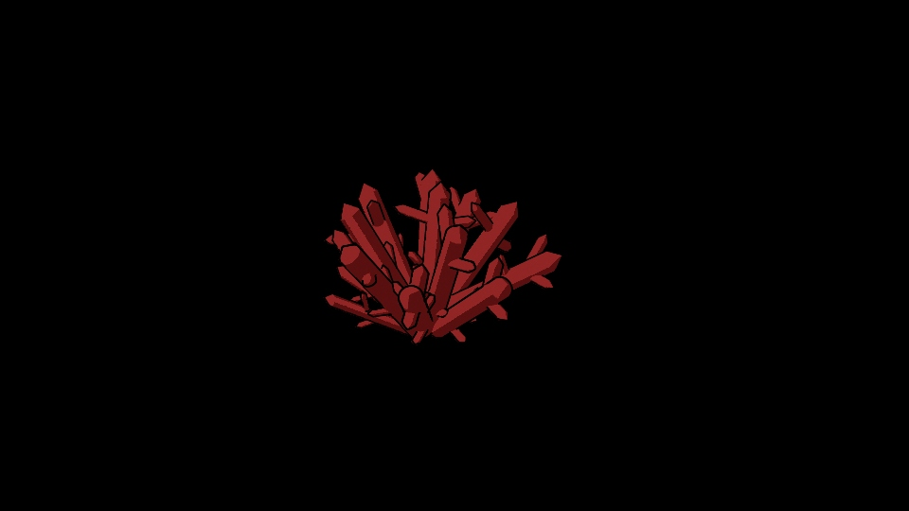
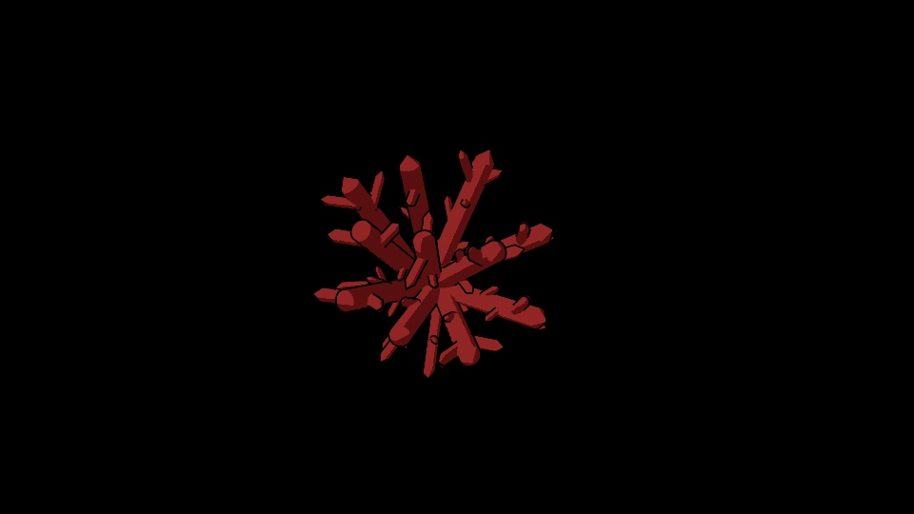
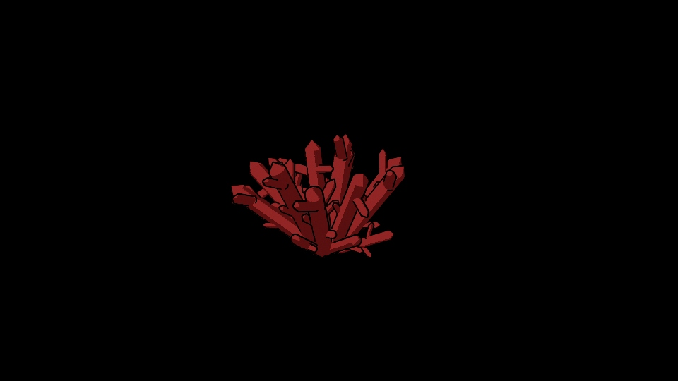

Coral- Melissa

Slide 17
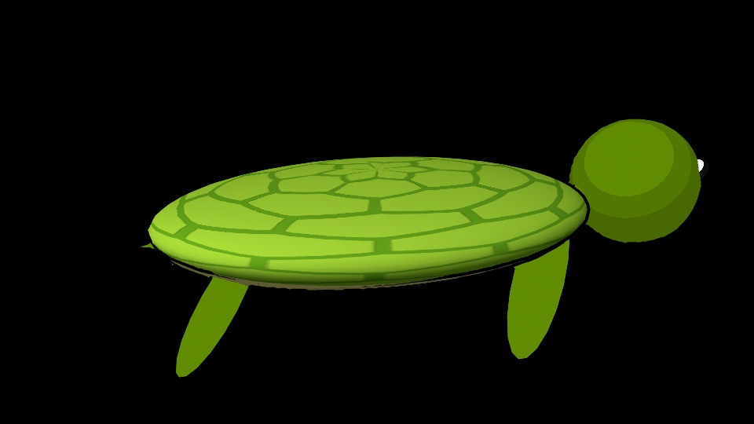
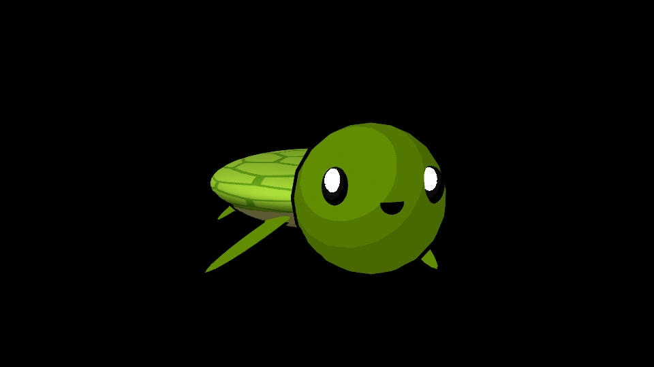
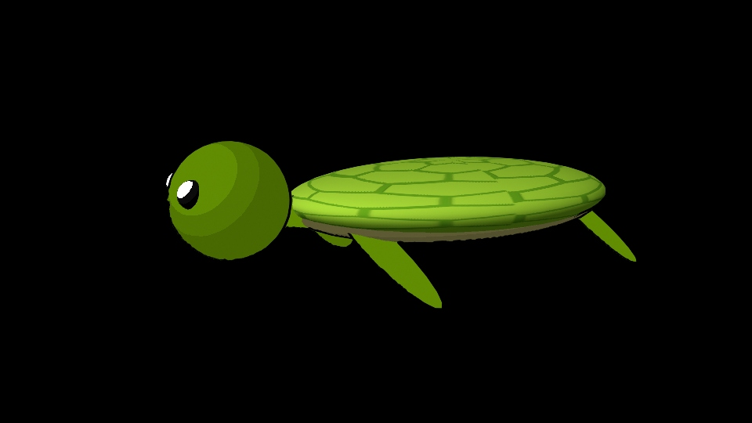
Sea Turtle- Melissa

Slide 18
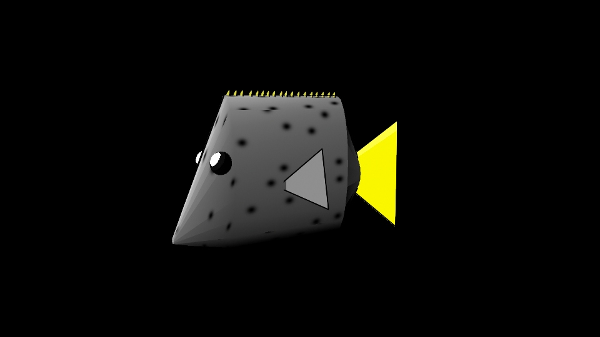
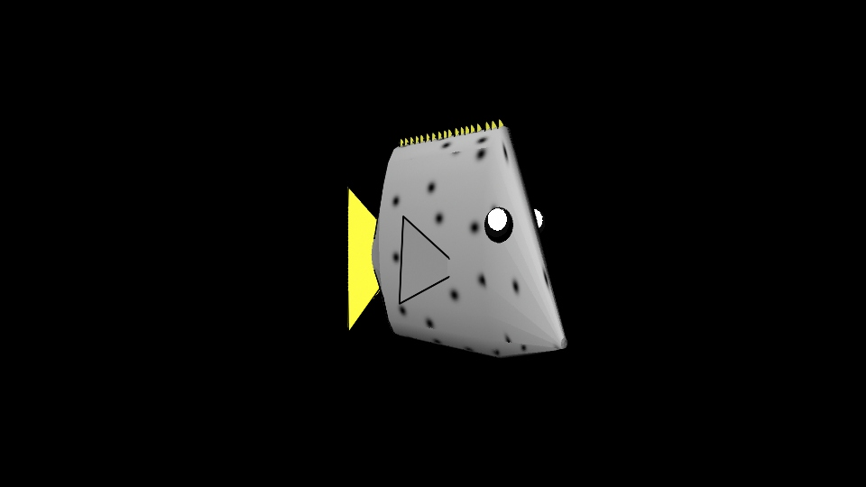
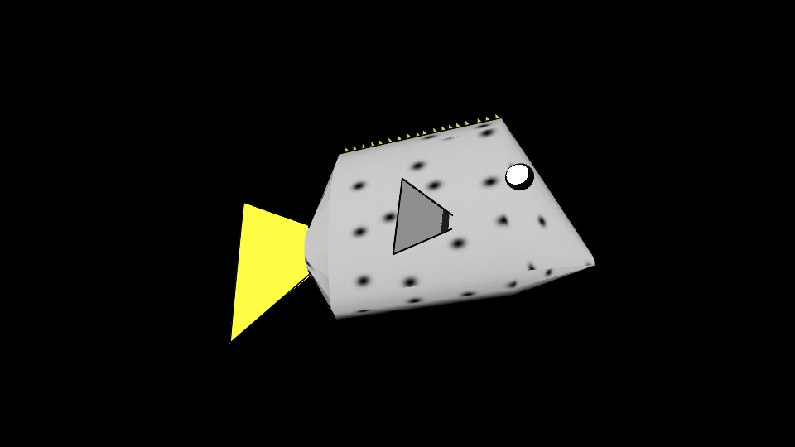
Surgeon Fish- Melissa

Slide 19
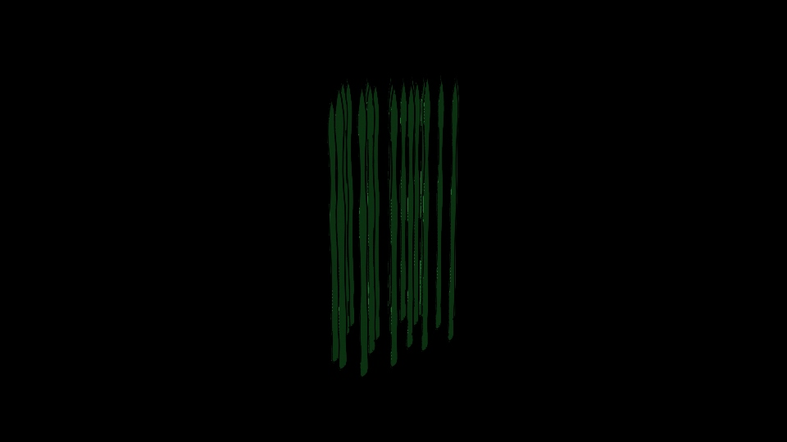
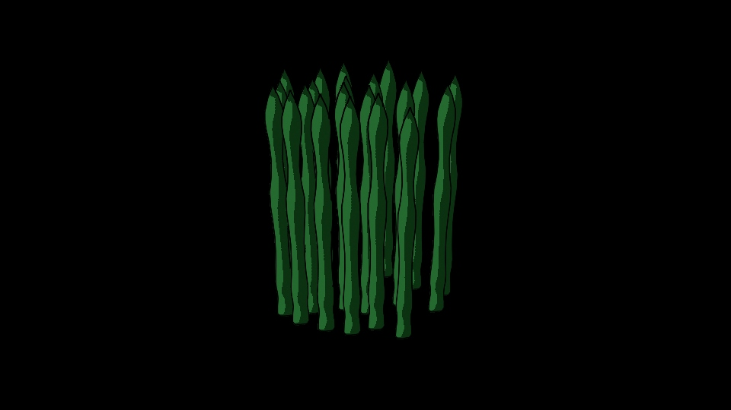
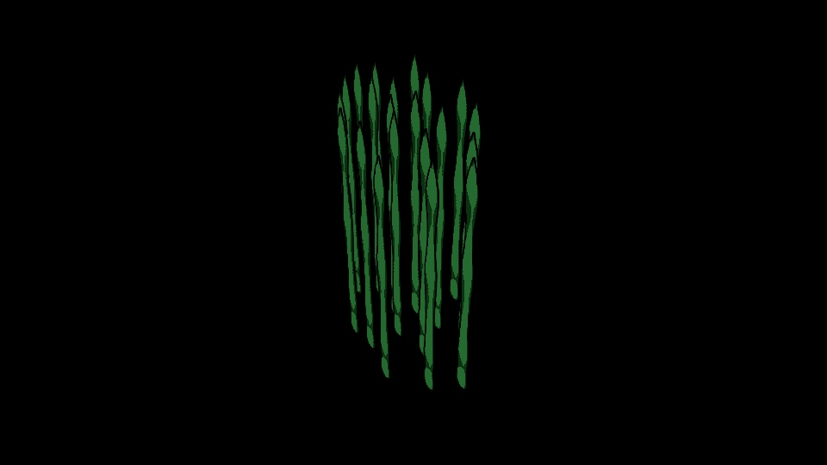
Seaweed

Slide 20
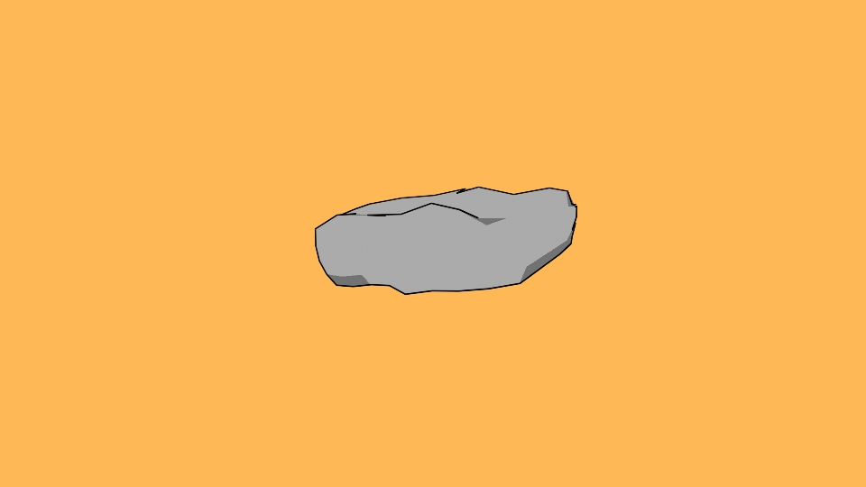
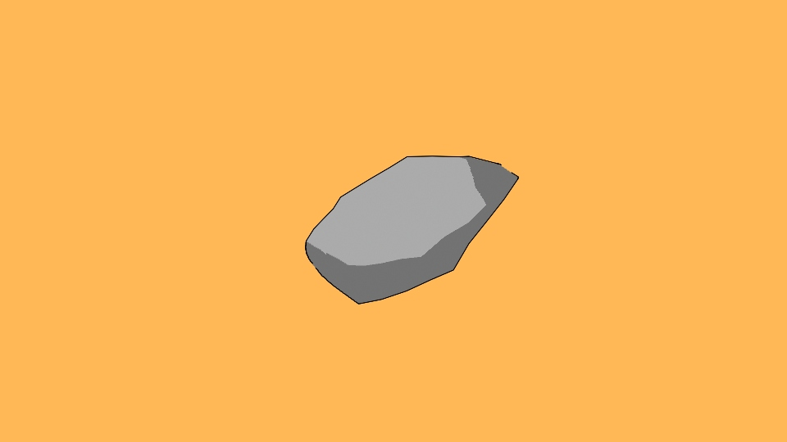
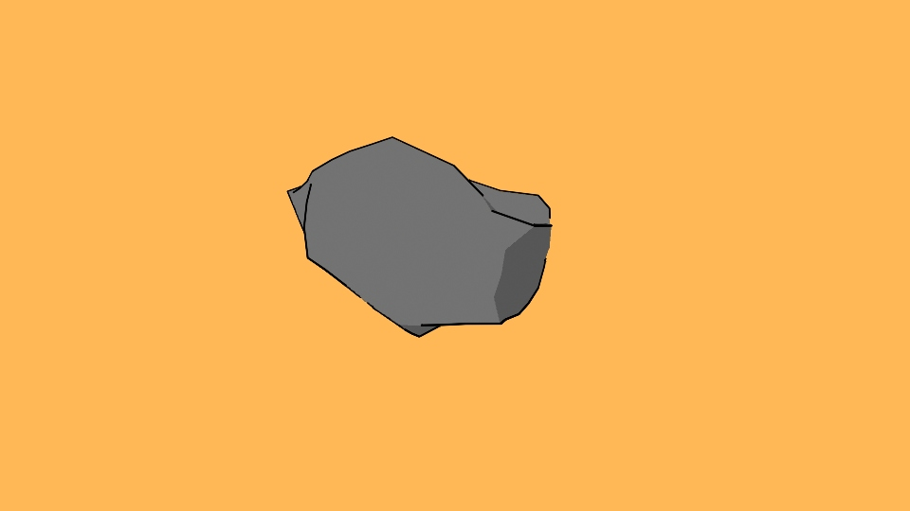
Rocks- Jacobus

Slide 21
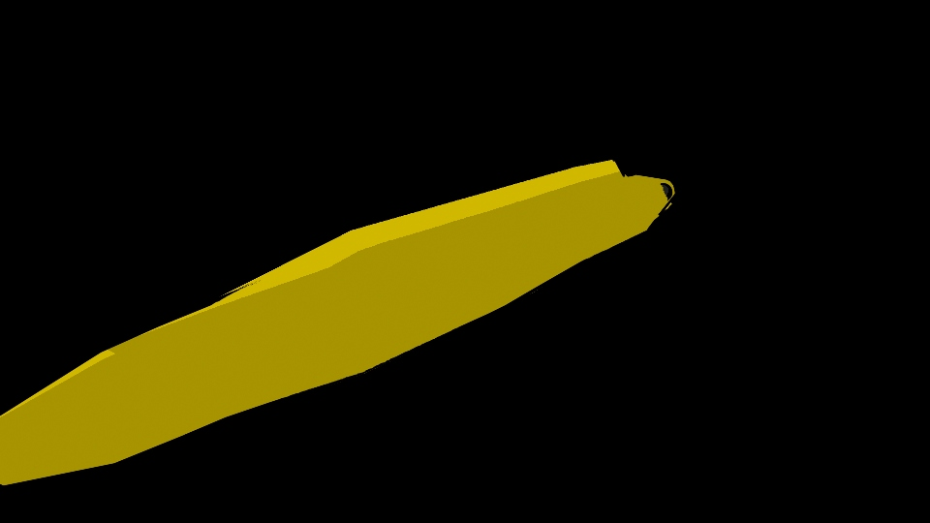
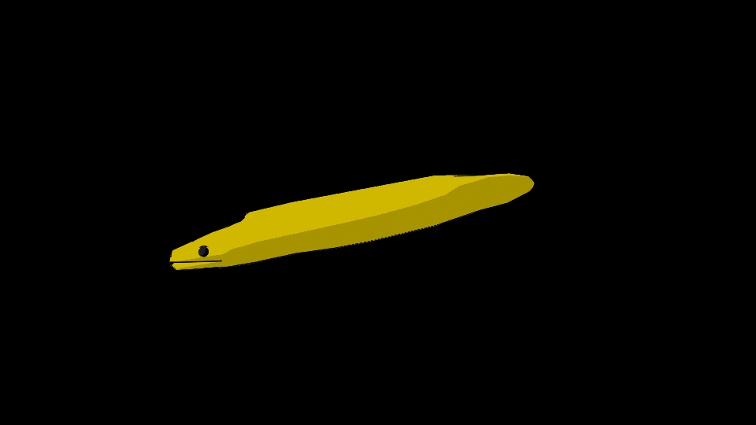
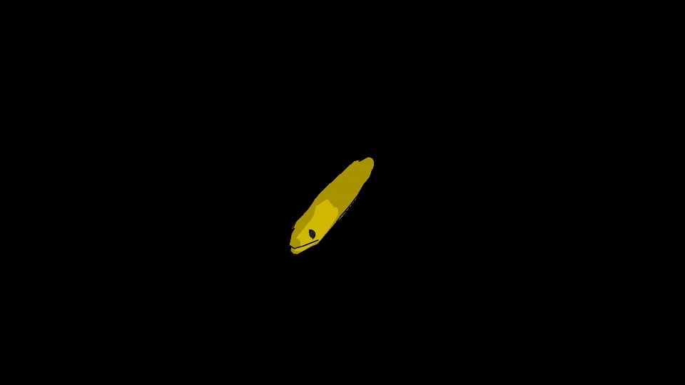
Moray Eel- Jacobus

Slide 22
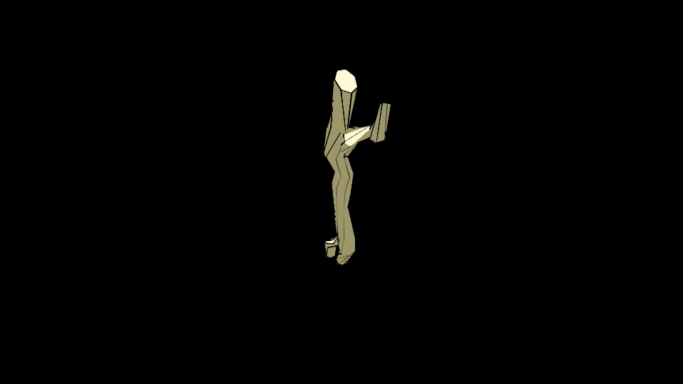

Driftwood- Jacobus

Slide 23

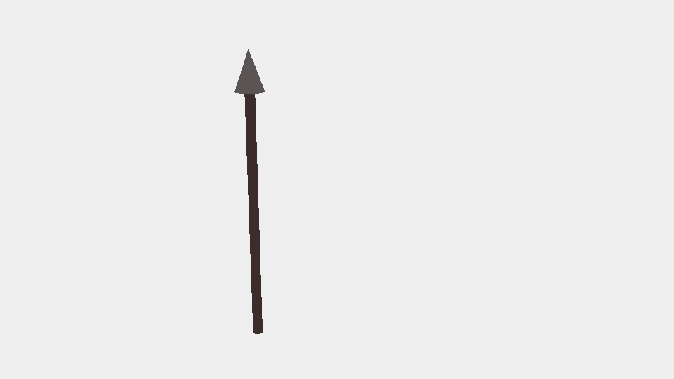
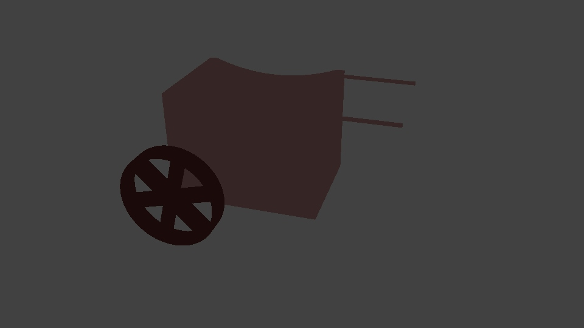
Chariot & Spear- Jared

Slide 24
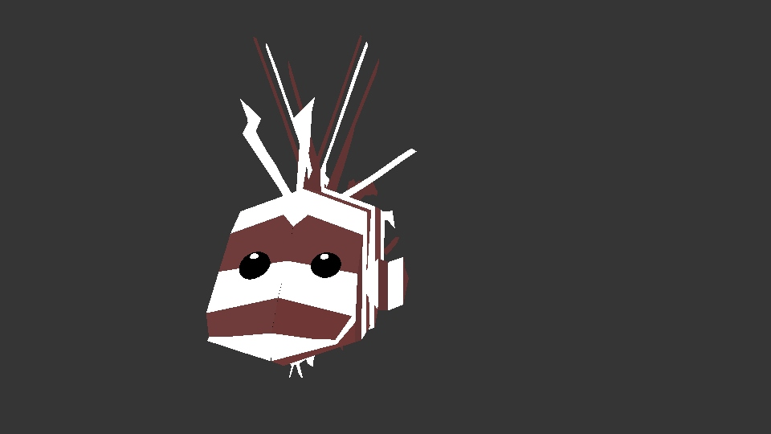
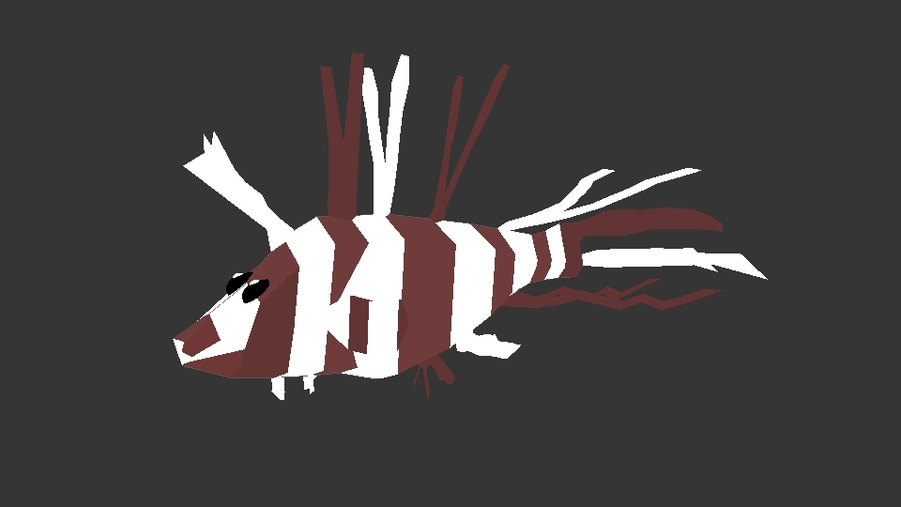
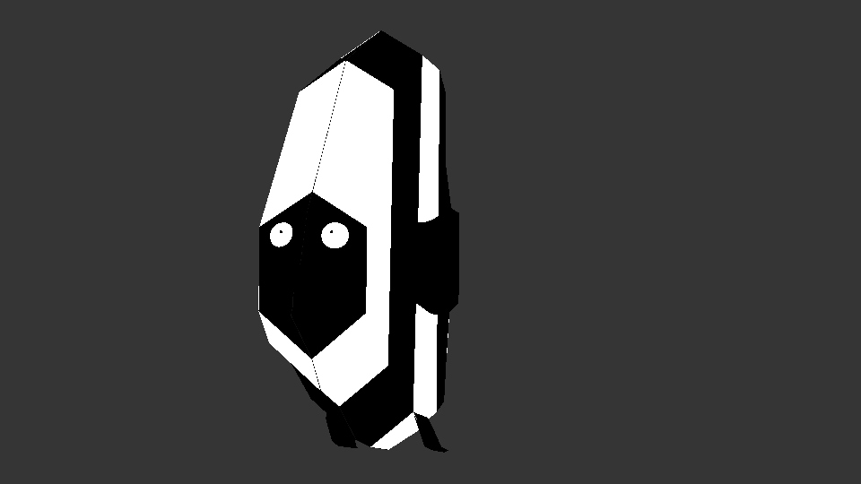
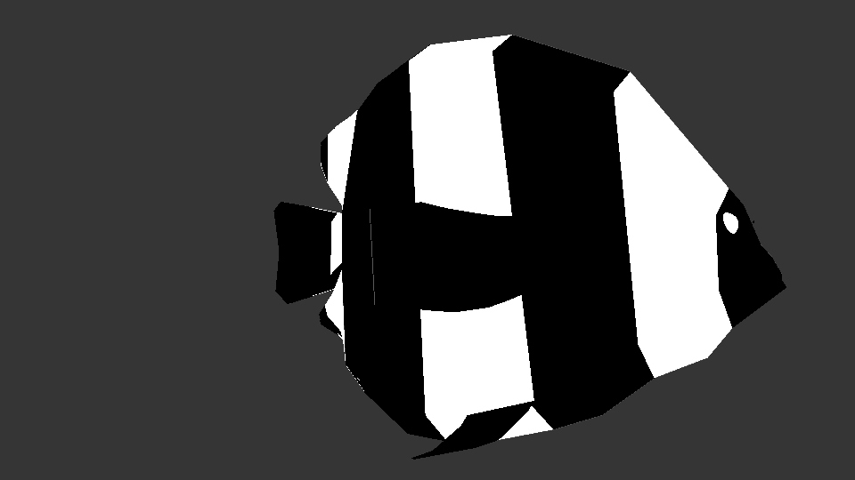
Lionfish & Humbug- Jared

Slide 25
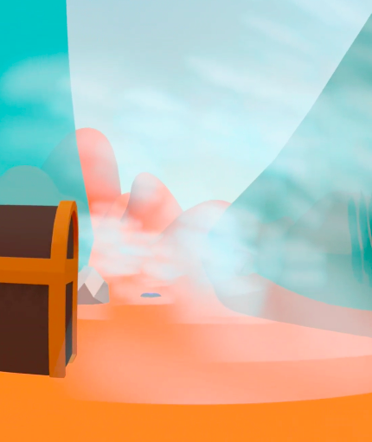


Virtual Environment Photos

Slide 26

Demo Video

Slide 27

Custom Soundtrack

Slide 28


Custom Sound Effects

Slide 29

Future Improvement
Development is still in process
Based on our survey, we have a few ways that people who have tested our project have expressed that they would like to see future improvement:
1. Interactivity
2. Sea Splitting
3. Sound Effects
4. Menu With Instructions
https://kids.nationalgeographic.com/nature/habitats/article/ocean
Notes:
1. Most users desired better interactivity. This means things like being able to open the treasure chest, catch fish, and grab Moses' staff
2. Another thing that we are working on is when the user, as Moses, grabs the spear and hits it on the ground, the sea will split with a cool animation
3. At present our application lacks sound. The desire for us is to add sound effects and background music
4. Finally, when testing the app we needed to explain the concept to the user. By placing a menu with instructions in our app we can allow players to figure out how to do this on their own

Slide 30
What We Learned From the Project
https://kids.nationalgeographic.com/nature/habitats/article/ocean
Notes:
Jared:
Melissa:
Jacobus:
Kieran:

Slide 31
Thank you!

